Slide 1

B.L.D.E.A’s V.P. Dr. P.G. HALAKATTI COLLEGE OF ENGINEERING AND TECHNOLOGY, VIJAYAPUR –586103.
INFORMATION SCIENCE AND ENGINEERING
“CYPHER CAM”
By: D Rahul Singh (2BL18IS013)
Parvat Mukartihal (2BL18IS026)
Guided By: Rahul Ambiger (2BL18IS033)
Prof: Pradeep Deshpande Shraddhanand B (2BL18IS035)

Slide 2
Project Phase-1
Contents
Introduction
Motivation
Literature review
Limitations of Existing Work
Problem Statement
Architecture
Features
Requirements
References

Slide 3
Introduction
Cypher Cam is a python based (GUI) application that uses icons and menus in order to manage interaction with the system.
The objective is to develop a system that monitors the area in which it is being implemented. It is used in order to enhance the camera based security systems.
Where as, Cypher Cam Works on any operating system which uses camera as hardware with other functionalities like LBPH and Haar-based algorithms that makes us to implement all the features.

Slide 4
Motivation
Arising crime, theft incidents, breaking traffic rules are major concern of today’s world.
To prevent such incidents we want to develop project called Cypher Cam that has various applications like:
Crime prevention.
Vehicle traffic control management.
Attendance system.
Used in banks, warehouses, shopping malls and retail stores.

Slide 5
Literature review
Topic:- Haar feature based Face Detection in OpenCV.
Authors:- K.Kadir, M.K.Kamaruddin and H.Nasir.
Year:- 2017
Publication:- IEEE(2017)
Description:- Face detection technique using OpenCV is developed in Python programming language. Where as, this application detects the faces and gives the information about the person by using Haar-based algorithms.

Slide 6
Literature review
Topic:- Motion Detection application using Frame Difference method.
Authors:- A.M.Husein, Calvin, David Halim, William.
Year:- 2018
Publication:- MECNIT(2018)
Description:- Frame differences is one of the most common method to be used to detect an object’s motion. This method is flexible as in capable to be modified and adjusted to match the system requirements. Background subtraction method can reduce a lot of noise created by static non-moving objects in the background.

Slide 7
Literature review
Topic:- Real-time Object detection and tracking using OpenCV.
Authors:- Chandan G, Ayush Jain, Harsh Jain, Mohana.
Year:- 2018
Publication:- IEEE(2018)
Description:- Objects are detected using LBPH algorithm in real time scenarios. Main Objective of LBPH algorithm to detect various objects in real time video sequence and track them in real time.This real time analysis of the ecosystem can yield great results by enabling security, order and utility for any enterprise.

Slide 8
LIMITATIONS of Existing work
Today’s CCTV are simply put, whatever happens they just sit and watch.
Requires human interaction to work properly.
They are not cost effective.
There are no advanced features included.
The normal cctv can’t find who is the thief in highly crowded areas.
Durability is less due to poor quality.

Slide 9
PROBLEM STATEMENT
The main objective of the project is to enhance cctv monitoring system which is lacking now a days. This project is fast, reliable, accurate in terms of working proficiency. This project helps to irradicate problems of old systems by adding multiple features like Face detection, Motion detection, Visitors in the room, Anti-theft alarming system etc, it uses image processing which will increase the efficiency of the system, which makes this a stand-alone project.

Slide 10
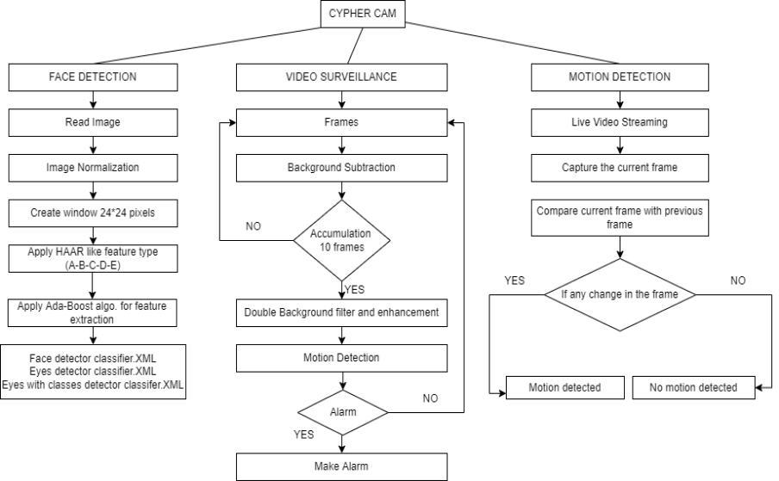
ARCHITECTURE

Slide 11
Features of Cypher Cam
Detects faces in frame using Haarcascade algorithm.
Detects motion in particular area.
Visitors in room will be detected.
Motion of person is detected.
Anti theft alarm sound is triggered.

Slide 12
How Cypher Cam is Different from Normal CCTV?
Features | Normal CCTV | Cypher Cam
Face Detection | NO | YES
Motion Detection | NO | YES
Visitors Detection | NO | YES
Anti Theft Alarming System | NO | YES

Slide 13
requirements
Software Requirements
Windows/Linux/Mac OS any version, hence it can run on any platform.
Python3, it need python to be installed in your system to run this project successfully.
Packages in python
OpenCV, skimage, numpy, tkinter, simpleaudio etc.

Slide 14
requirements
Hardware Requirements
In terms of hardware requirements there is not much required at all but still below requirements are must :
PC/Laptop with atleast 4GB RAM.
Processor:- i3 or above.
Webcam with appropriate drivers installed.
Flashlight/ LED if using this at night.

Slide 15
references
Research paper on Haar-feature based face detection using OpenCV published in IEEE-2017 (Institute of Electrical and Electronics engineers) by K.Kadir, M.K.Kamaruddin and H.Nasir.
Research paper on Motion Detection application using Frame Difference method published in MECNIT-2018 (International conference on Mechanical, Electronics, Computer and Industrial technology) by A.M.Husein, Calvin, David Halim, William.
Research paper on Real-time Object detection and tracking using OpenCV published in IEEE-2018 (Institute of Electrical and Electronics engineers) by Chandan G, Ayush Jain, Harsh Jain, Mohana.

Slide 16
Thank you

